Slide 1
West Virginia Lexile and Quantile Measures Report

Slide 2
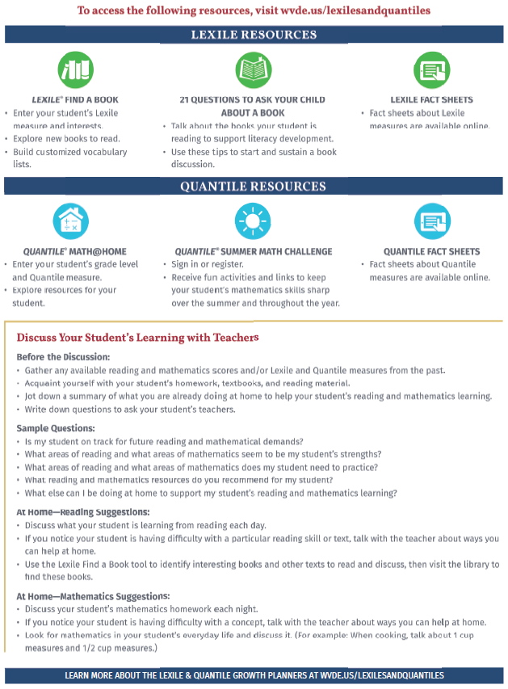
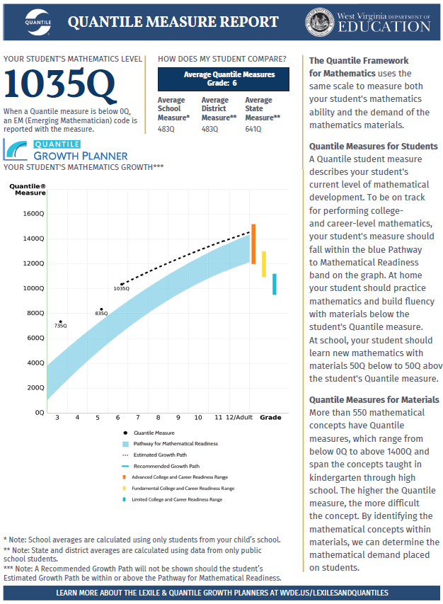
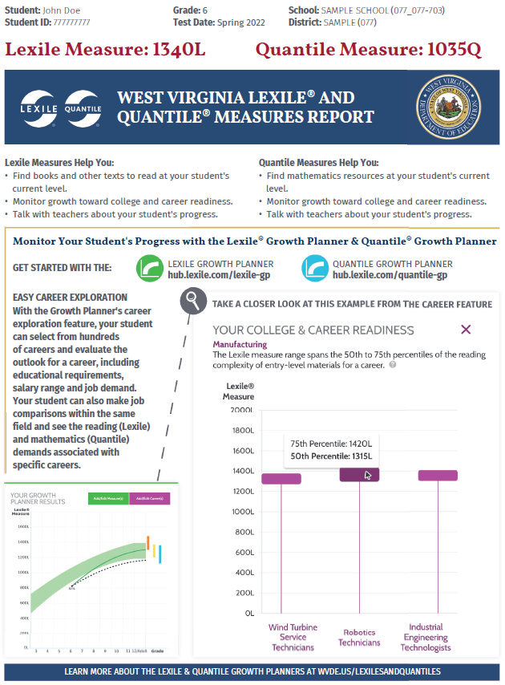
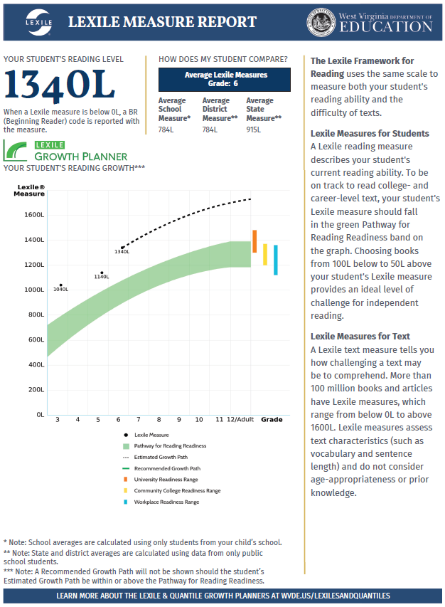
Annual Training
Notes:
The WV Parent Report for Lexile and Quantile Measures is a four-page report to be distributed to parents in the Fall. The 1st page of the report lists the student’s Lexile and Quantile Measures, a brief description of the measures, and introduces the Growth Planner. The 2nd page is all about Lexile Measures. The 3rd page is about Quantile Measures. And, finally, the last page offers resources and discussion questions for parents.

Slide 3
What are Lexile Measures?
The Lexile Framework for Reading is a scientific approach that places both the reader and the text on the same developmental scale, making it easy to connect your student with books targeted to his or her reading ability.
LEXILES

Slide 4
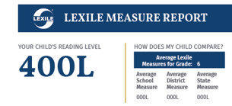
Using Lexile Measures
Your student receives a Lexile reader measure from the West Virginia General Summative Assessment, Grades 3-8 or the SAT School Day.
More than 100 million books, articles, and websites have received Lexile text measures based on factors such as vocabulary and complexity.
LEXILES

Slide 5
Lexile Measure for Texts =
Sentence Length
Word Length
Unknown Words
LEXILES
Notes:
To define the quantitative measure of a text, the number of words in each sentence, the number of syllables in each word, and the number of unknown words in the text are analyzed. Texts with longer sentences, multi-syllabic words, or specialized vocabulary have a higher Lexile measure than texts with simpler sentences, shorter words, or more commonly known words.

Slide 6
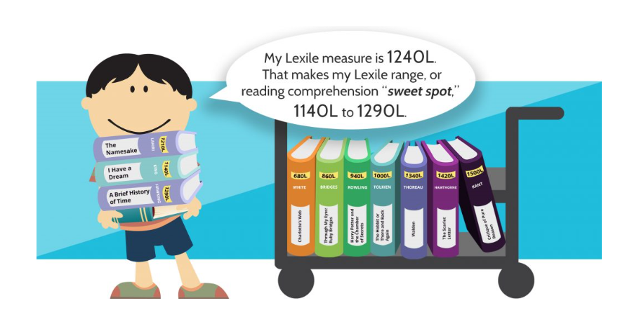
Using Lexile Measures
You and your student should look for reading materials with a reading comprehension “sweet spot” of 100L below to 50L above his or her reported Lexile measure. Reading materials in this range will provide an ideal level of challenge while maintaining comprehension.
LEXILES

Slide 7
What are Quantile Measures?
The Quantile Framework for Mathematics helps identify the math concepts your student knows and matches your student with the concepts he or she is ready to learn.
QUANTILES

Slide 8
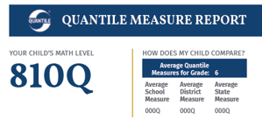
Using Quantile Measures
Your student receives a Quantile measure from the West Virginia General Summative Assessment, Grades 3-8 or the SAT School Day.
The Quantile Framework for Mathematics has defined almost 500 mathematical skills and/or concepts. Each of these concepts has a measure, and each measure shows how difficult one skill is in relationship to the others.
QUANTILES

Slide 9
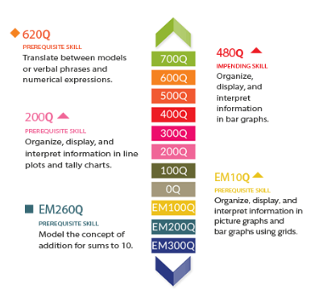
Using Quantile Measures
For optimal learning and growth, your student should practice mathematics within a Quantile range of 50Q above and 50Q below his or her Quantile measure.
QUANTILES

Slide 10
Readiness for Mathematics Instruction
Quantile Measure of Mathematical Concept
50Q Above
Student’s Quantile Measure
50Q Below
QUANTILES
Notes:
Matching Your Student To Math Concepts That Make Sense
Quantile measures are so much more than a math score because they also measure math skills and concepts. A Quantile Skill and Concept (QSC) measure helps teachers and parents target instruction by matching these two measures.
As the difficulty or demand of the skill increases, so does the Quantile measure. The difference between your student’s Quantile measure and the QSC measure predicts how difficult that skill or concept may be for a child to learn. For optimal learning and growth, a student should practice mathematics within a Quantile range of 50Q above and 50Q below his or her Quantile measure.

Slide 11
Lexile and Quantile Similarities
Developmental scales
Measure students and resources on the same scale (resources = books for Lexile, math concepts or skills for Quantile)
Instructional implications
LEXILE and QUANTILE SIMILARITIES
Notes:
For many years, West Virginia educators have used Lexile measures to gauge student performance in reading. The West Virginia College- and Career- Readiness Standards for English Language Arts recognize the range of Lexile measures for each programmatic level. The measures indicate grade-level expectations for students, and assist educators as they scaffold instruction to address student needs.
Quantile measures are a recent addition to our summative assessment data. Quantile measures provide similar developmental scales for students’ mathematical readiness. Resources are aligned to the Quantile Scale to appropriately introduce mathematical concepts--- and educators can utilize the scale to inform instruction.

Slide 12
Lexile and Quantile Differences
The Lexile measure describes the student’s reading ability.
The Quantile measure indicates the student’s readiness for mathematical instruction.
LEXILE and QUANTILE DIFFERENCES
Notes:
A student reading at a Lexile measure of 650L can comprehend 75% percent of the materials and read texts independently at that measure.
A student with a Quantile measure 650Q is READY to learn concepts introduced at that level.
The difference between Lexile measures and Quantile measures is easily understood as Lexile measures describe reading ability at the time, Quantile measures describe a student’s readiness to learn a specific concept.

Slide 13
Benefits
Link students’ abilities
Forecast student success
Differentiate instruction
Track growth over time
BENEFITS
Notes:
Benefits of The Lexile and Quantile Frameworks include
LINKING students’ abilities to skill difficulty
FORECASTING students’ success rate
DIFFERENTIATING instruction for struggling students and offering enrichment opportunities for more proficient students
TRACKING growth over time

Slide 14
West Virginia Lexile and Quantile Measures Report
Notes:
Let’s look at the report page-by-page.

Slide 15
Student Information
Quantile Measure
Lexile Measure
Growth Planner Information
REPORT – PAGE 1

Slide 16
Each grade-level box represents the Lexile range for reading skills and college and career readiness to which students should aspire.
LEXILE – COLLEGE/CAREER READINESS
Notes:
Is your student on the path to being College and Career “Reading Ready”?
The colored bars at the far right of this chart represent the complexity of texts students will encounter upon high school graduation as they transition to post-secondary endeavors.

Slide 17
Each grade-level box represents the Quantile range for math skills and college and career readiness to which students should aspire.
QUANTILE – COLLEGE/CAREER READINESS
Notes:
On this slide, you see the college and career “pathway” for mathematics.
At the far right of the chart, the blue box represents the range of mathematics difficulty present in math materials for college and careers.

Slide 18
Math and Reading Demands of Career Entrance
The Lexile and Quantile measures are the only metrics available to compare and describe the reading and mathematics demands of careers.
GROWTH PLANNER
Notes:
MetaMetrics is researching the reading and mathematical demands of more than 400 high-interest and high-demand occupations. For example, a student interested in a career as an electrician should have a reading skill of about 1270Lexiles and a mathematical skill of about 1045Quantiles to be prepared for this profession.
This kind of information is available for a variety of careers and can help students better imagine the “finish line” for their own learning based on their own unique goals.

Slide 19
Growth Planner
Recommendation:
Use either Firefox
or Chrome as your
web browser.
Lexile Growth Planner: ccr.lexile.com/wv
Quantile Growth Planner: ccr.quantiles.com/wv
GROWTH PLANNER
Notes:
The Lexile Growth Planner can be used to illustrate the reading demands of different occupations.
The Quantile Growth Planner can be used to illustrate the mathematical demands of different occupations.
On this site it is necessary to enter a specific Lexile or Quantile measure for a student. Use the Add/Edit measure tab. The Test Date and School Year Start Date need only be estimates. After entering the information, use the GRAPH ME tab to open a graph that projects student progress toward college- and career-readiness. Use the pull-down menu to access the available career choices. MetaMetrics continues to develop this site and add additional career options.

Slide 20
In this example, the 6th grade student has a Lexile Measure of 400L and is projected to graduate high school with a Lexile Measure of about 800L.
The selected career is Manufacturing Production Technician. The Lexile range for this career is from 1110L to about 1300L.
Information regarding this career:
Current median wage - $62,230
Projected job openings – 7100
Education level required –
Associate’s Degree
Post-Secondary Certification
14 Years
Some intervention would be required to strengthen this student’s reading abilities for him or her to be career-ready.
LEXILE GROWTH PLANNER

Slide 21
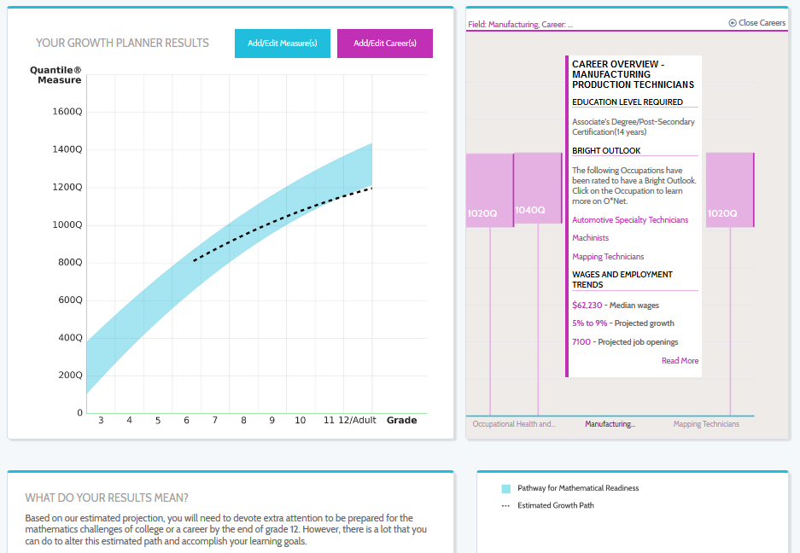
In this example, the 6th grade student has a Quantile Measure of 810Q and is projected to graduate high school with a Quantile Measure of about 1200Q.
The selected career is Manufacturing Production Technician. The Quantile range for this career is from 1040Q to about 1400Q.
Information regarding this career:
Current median wage - $62,230
Projected job openings – 7100
Education level required –
Associate’s Degree
Post-Secondary Certification
14 Years
This student is on track for to be ready for this career.
QUANTILE GROWTH PLANNER

Slide 22
West Virginia Lexile and Quantile Measures Report

Slide 23
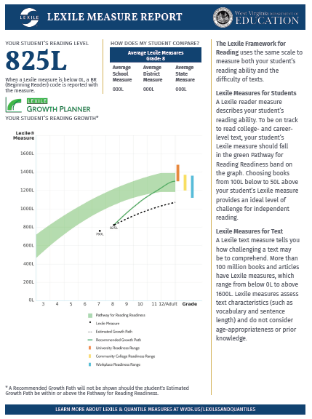
Page 2 of this report is all about your student’s Lexile Measure.
You will find:
YOUR STUDENT’S LEXILE MEASURE
Notes:
23

Slide 24
Page 2 of this report is all about your student’s Lexile Measure.
You will find:
Your student’s Reading Level (Lexile Measure)
YOUR STUDENT’S LEXILE MEASURE
Notes:
24

Slide 25
Page 2 of this report is all about your student’s Lexile Measure.
You will find:
Your student’s Reading Level
The average Lexile Measures for your student’s grade at the school level, the district/county level, and the state level
YOUR STUDENT’S LEXILE MEASURE
Notes:
25

Slide 26
Page 2 of this report is all about your student’s Lexile Measure.
You will find:
Your student’s Reading Level
The average Lexile Measures for your student’s grade at the school level, the district/county level, and the state level
Your student’s Growth Planner for reading, illustrating:
The pathway for Reading Readiness
YOUR STUDENT’S LEXILE MEASURE
Notes:
26

Slide 27
Page 2 of this report is all about your student’s Lexile Measure.
You will find:
Your student’s Reading Level
The average Lexile Measures for your student’s grade at the school level, the district/county level, and the state level
Your student’s Growth Planner for reading, illustrating:
The pathway for Reading Readiness
Your student’s historical Lexile Measures
YOUR STUDENT’S LEXILE MEASURE
Notes:
27

Slide 28
Page 2 of this report is all about your student’s Lexile Measure.
You will find:
Your student’s Reading Level
The average Lexile Measures for your student’s grade at the school level, the district/county level, and the state level
Your student’s Growth Planner for reading, illustrating:
The pathway for Reading Readiness
Your student’s Lexile Measures
Your student’s estimated growth plan
YOUR STUDENT’S LEXILE MEASURE
Notes:
28

Slide 29
Page 2 of this report is all about your student’s Lexile Measure.
You will find:
Your student’s Reading Level
The average Lexile Measures for your student’s grade at the school level, the district/county level, and the state level
Your student’s Growth Planner for reading, illustrating:
The pathway for Reading Readiness
Your student’s Lexile Measures
Your student’s estimated growth plan
Your student’s recommended growth plan
YOUR STUDENT’S LEXILE MEASURE
Notes:
29

Slide 30
West Virginia Lexile and Quantile Measures Report

Slide 31
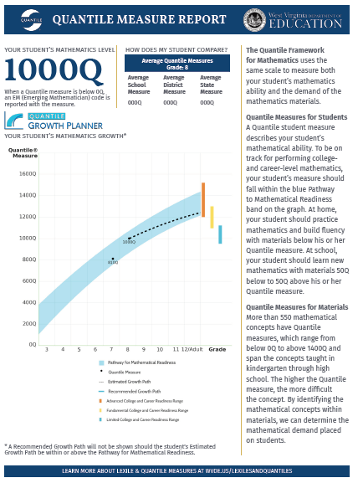
YOUR STUDENT’S QUANTILE MEASURE
Page 3 of this report is all about your student’s Quantile Measure.
You will find:

Slide 32
Page 3 of this report is all about your student’s Quantile Measure.
You will find:
Your student’s Math Level (Quantile Measure)
YOUR STUDENT’S QUANTILE MEASURE

Slide 33
YOUR STUDENT’S QUANTILE MEASURE
Page 3 of this report is all about your student’s Quantile Measure.
You will find:
Your student’s Math Level
The average Quantile Measures for your student’s grade at the school level, the district/county level, and the state level

Slide 34
YOUR STUDENT’S QUANTILE MEASURE
Page 3 of this report is all about your student’s Quantile Measure.
You will find:
Your student’s Math Level
The average Quantile Measures for your student’s grade at the school level, the district/county level, and the state level
Your student’s Growth Planner for math, illustrating:
The pathway for Mathematical Readiness

Slide 35
Page 3 of this report is all about your student’s Quantile Measure.
You will find:
Your student’s Math Level
The average Quantile Measures for your student’s grade at the school level, the district/county level, and the state level
Your student’s Growth Planner for math, illustrating:
The pathway for Mathematical Readiness
Your student’s historical Quantile Measures
YOUR STUDENT’S QUANTILE MEASURE

Slide 36
Page 3 of this report is all about your student’s Quantile Measure.
You will find:
Your student’s Math Level
The average Quantile Measures for your student’s grade at the school level, the district/county level, and the state level
Your student’s Growth Planner for math, illustrating:
The pathway for Mathematical Readiness
Your student’s current Quantile Measure
Your student’s estimated growth plan
YOUR STUDENT’S QUANTILE MEASURE

Slide 37
Page 3 of this report is all about your student’s Quantile Measure.
You will find:
Your student’s Math Level
The average Quantile Measures for your student’s grade at the school level, the district/county level, and the state level
Your student’s Growth Planner for math, illustrating:
The pathway for Mathematical Readiness
Your student’s current Quantile Measure
Your student’s estimated growth plan
Your student has no recommended growth plan because the estimated growth plan falls within the pathway for mathematical readiness
YOUR STUDENT’S QUANTILE MEASURE

Slide 38
West Virginia Lexile and Quantile Measures Report

Slide 39
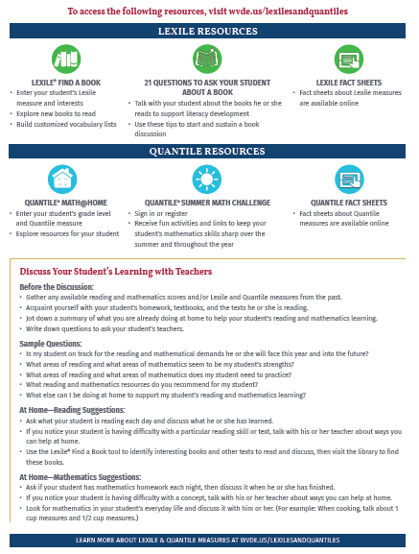
To view resources visit: wvde.us/LexilesandQuantiles/
PAGE 4 - RESOURCES

Slide 40
RESOURCES

Slide 41
LEXILE HUB

Slide 42
Whether you’re looking for biographies or mystery novels. Lexile measures can help you find books matching your student’s reading level. You can use his or her Lexile reader measure as a starting point to connect your student with books that are engaging, have the right amount of challenge, and will keep your student comprehending the text.
FIND A BOOK

Slide 43
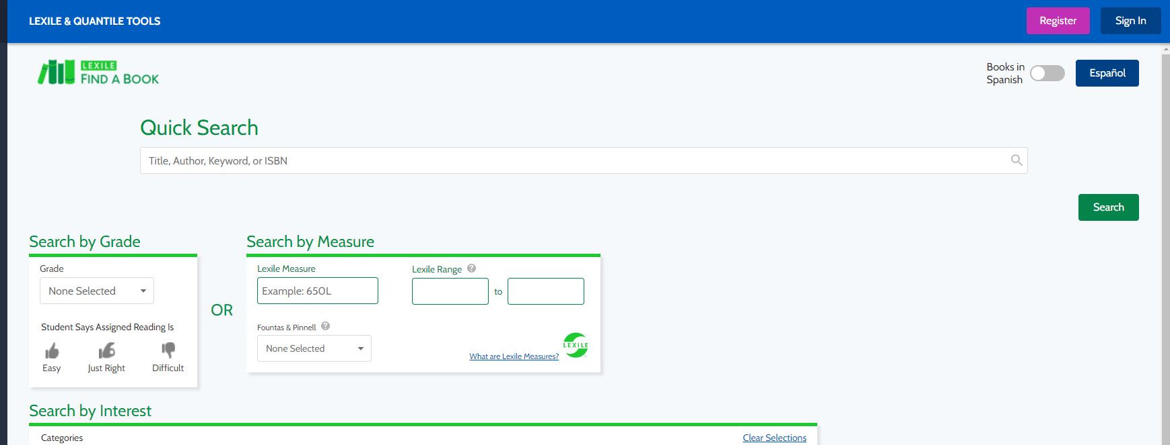
Enter your student’s Lexile Measure.
The Lexile Range automatically populates.
FIND A BOOK

Slide 44
Enter your student’s Lexile Measure.
The Lexile Range automatically populates.
FIND A BOOK

Slide 45
Enter your student’s Lexile Measure.
The Lexile Range automatically populates.
Click “Search.”
FIND A BOOK

Slide 46
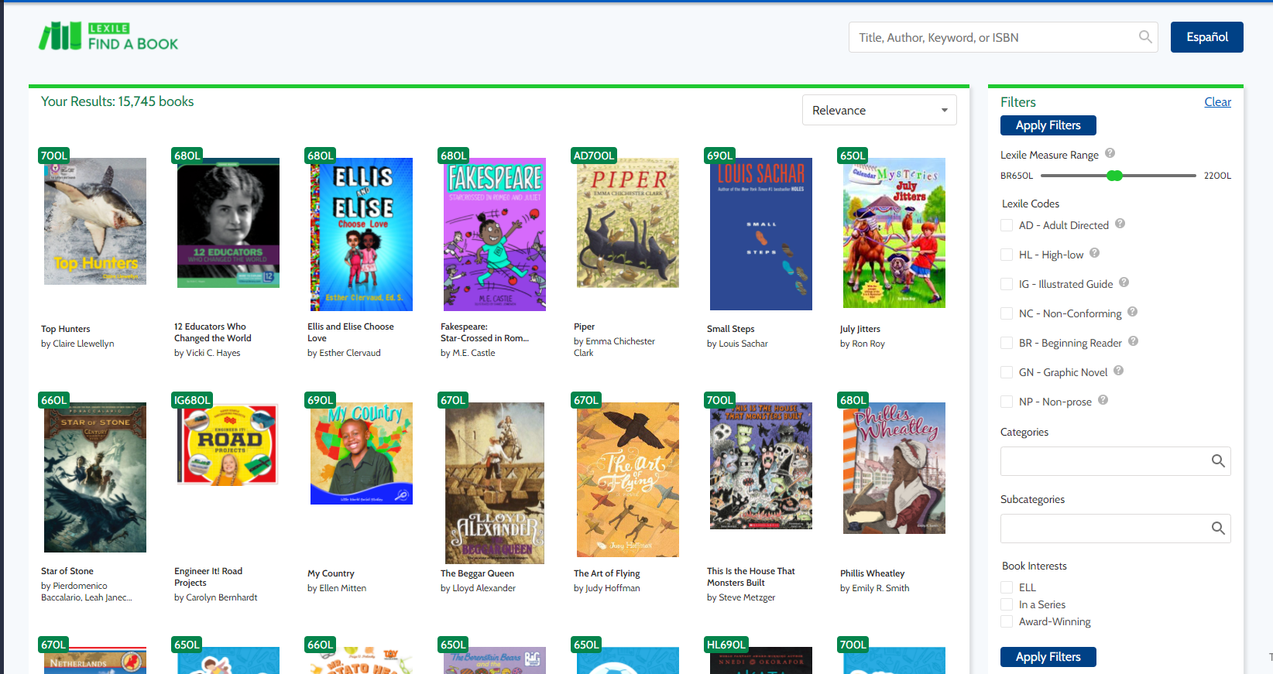
Select a book by clicking on the cover.
FIND A BOOK

Slide 47
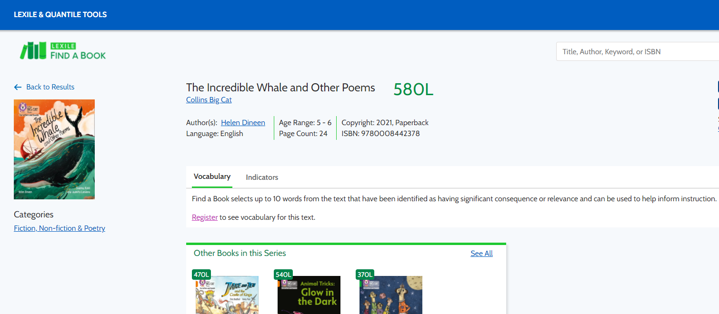
Provides additional information on the book selected.
FIND A BOOK

Slide 48
Select a book by clicking on the cover.
Or search for books by selecting filters before clicking “Apply Filters”
FIND A BOOK

Slide 49
LEXILE RESOURCES

Slide 50
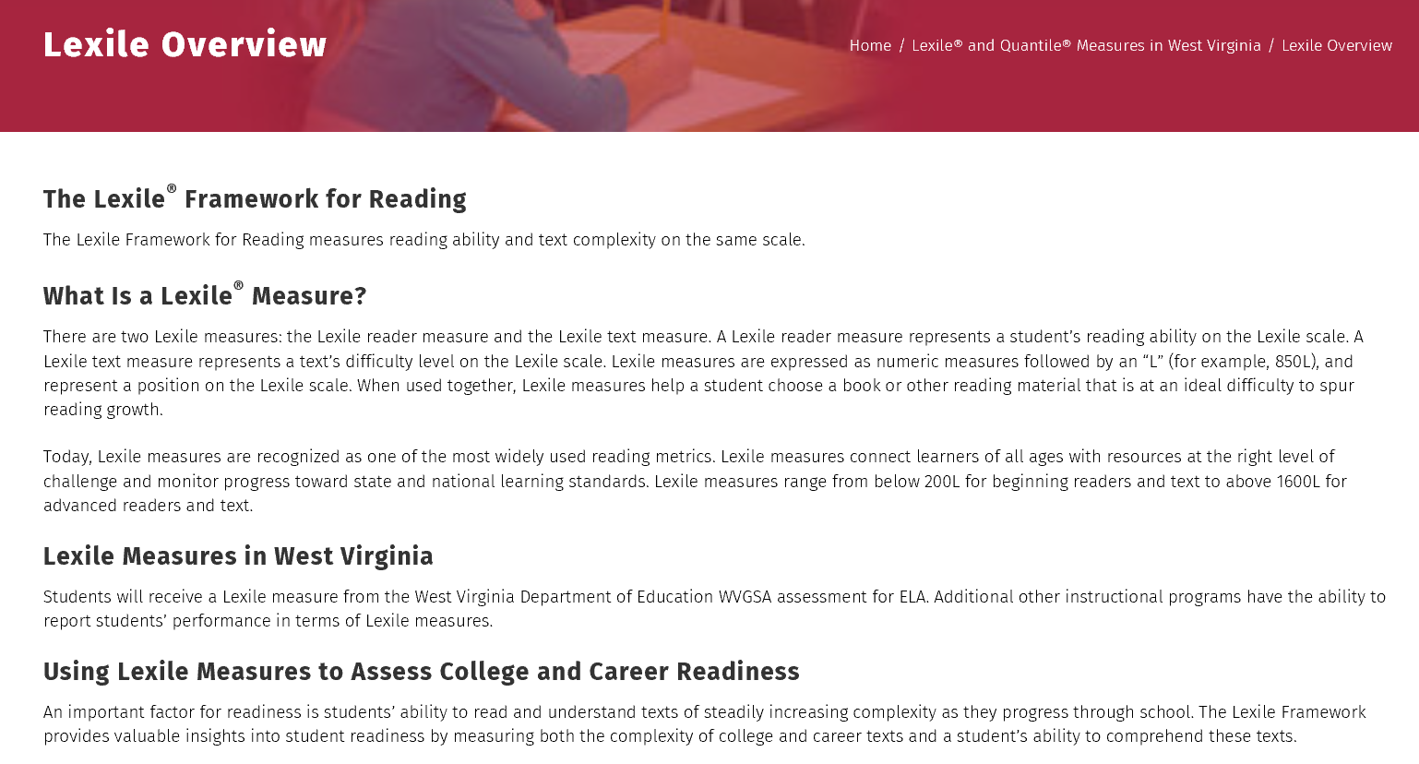
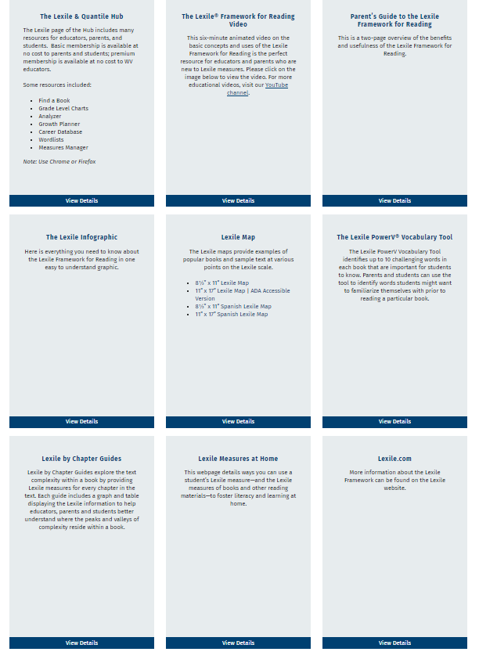
LEXILE RESOURCES

Slide 51
Listed on the Lexile page are several resources.
Below are directions to locate additional Lexile resources detailed on the West Virginia Lexile and Quantile Measures Report.
LEXILE RESOURCES

Slide 52
Talking to your student about the books he or she reads is one of the best ways to support your student’s literacy development. Your student needs to engage in critical thinking to discuss a book – a key skill for success in school as well as life.
21 QUESTIONS

Slide 53
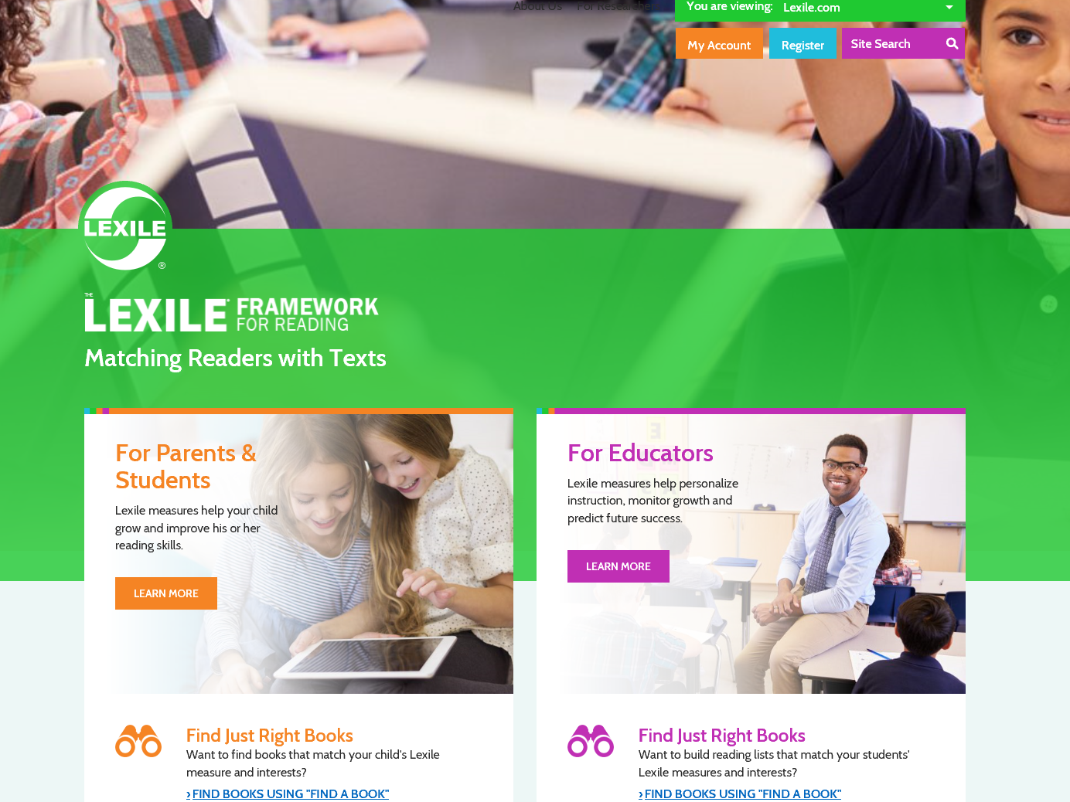
Click on “Learn More.”
21 QUESTIONS

Slide 54
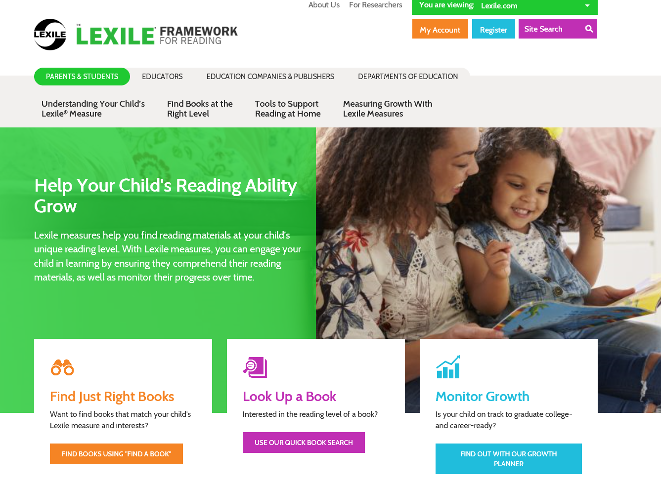
Click on “Tools to Support Reading at Home.”
21 QUESTIONS

Slide 55
Click on “21 questions to ask your child.”
21 QUESTIONS

Slide 56
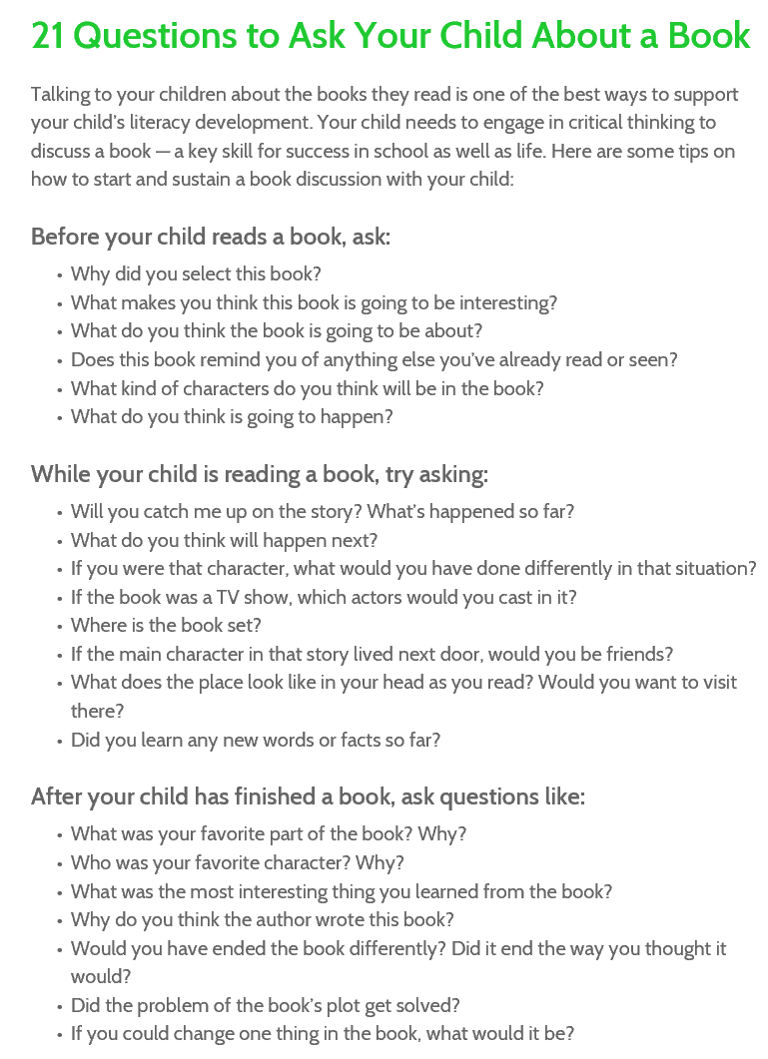
21 QUESTIONS

Slide 57
You can learn more about The Lexile Framework for Reading by downloading free resources.
FACT SHEETS

Slide 58
Click on “Learn More.”
FACT SHEETS

Slide 59
Click on “Understanding Your Child’s Lexile Measure.”
FACT SHEETS

Slide 60
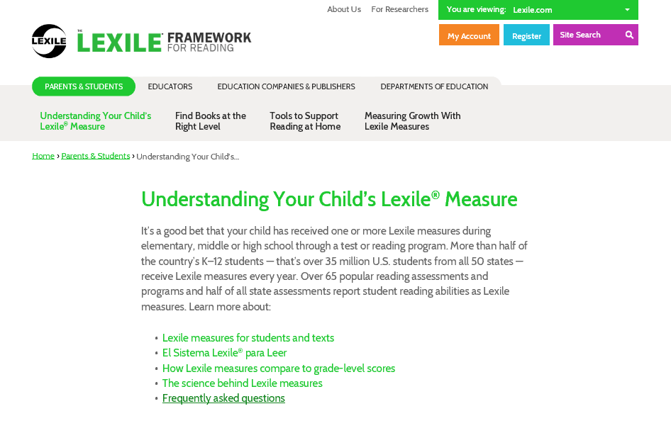
Click on “Frequently asked questions.”
FACT SHEETS

Slide 61
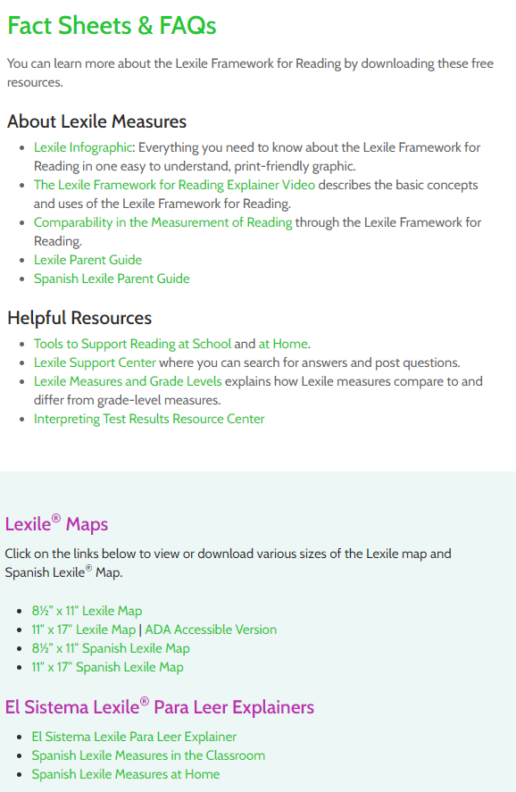
There are many resources to help you understand Lexile Measures and your student’s reading level.
FACT SHEETS

Slide 62
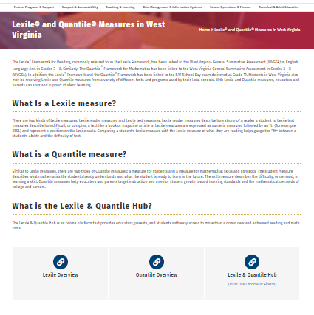
Click here to find many quantile resources located on the hub
One of those resources is discussed on the following slides
QUANTILE HUB

Slide 63
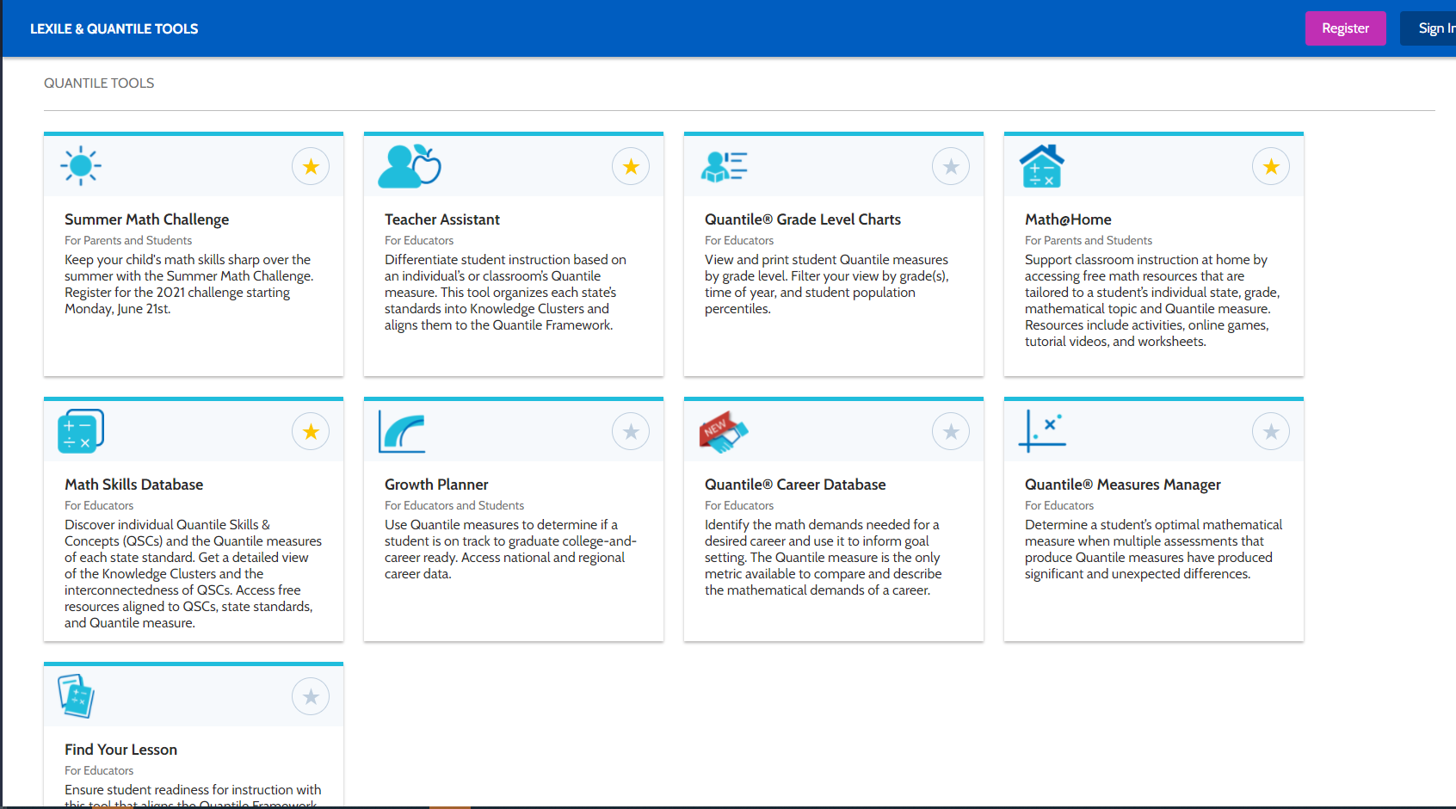
MATH@HOME

Slide 64
Math@Home is a free website full of tools and family-friendly activities to support students’ mathematics learning. With Math@Home, you can find activities to do with your student at home, covering specific concepts at the right level of difficulty. With one simple step, you can build a customized list of materials and activities matching your student’s unique ability level and learning goals.
MATH@HOME

Slide 65
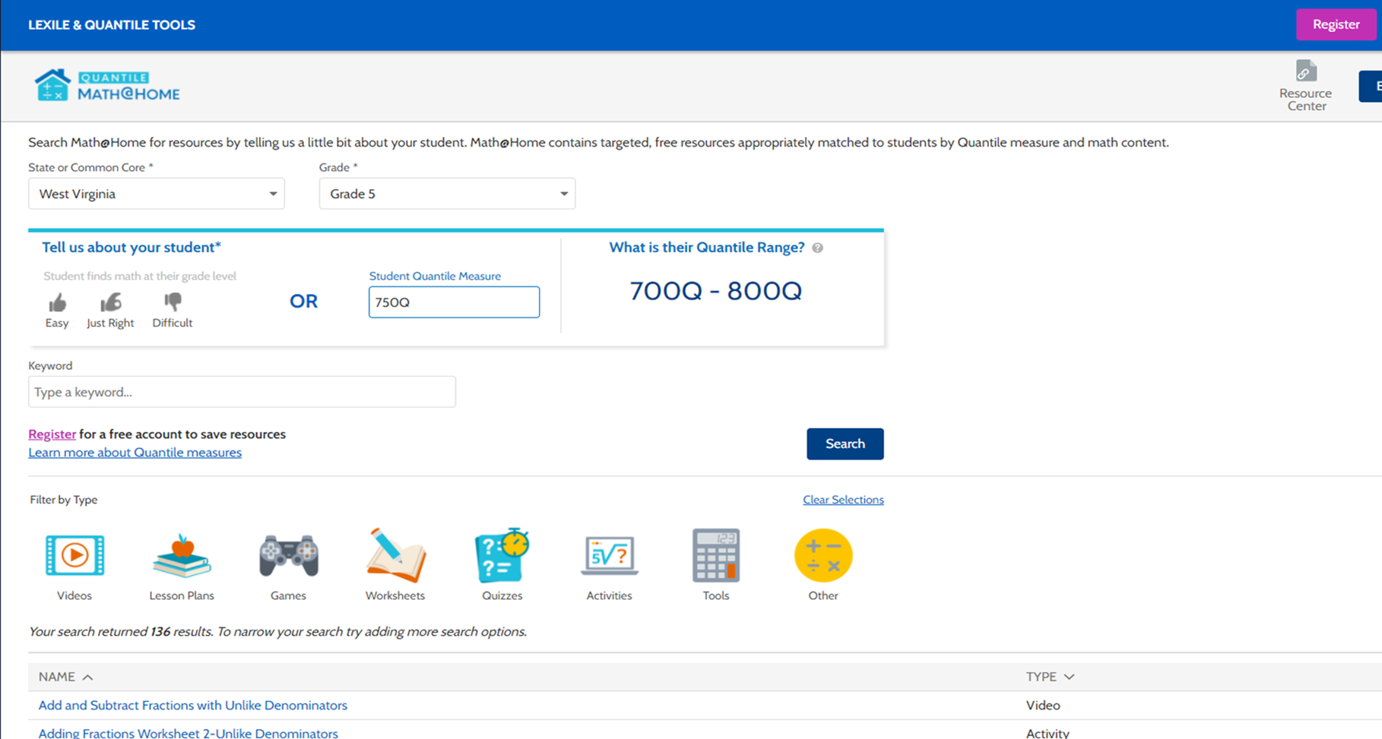
Select State – West Virginia
Select Grade
Enter your student’s Quantile Measure.
The Quantile Range automatically populates.
Click “Search.”
MATH@HOME

Slide 66
Select State – West Virginia
Select Grade
Enter your student’s Quantile Measure.
The Quantile Range automatically populates.
Click “Search.”
MATH@HOME

Slide 67
Select State – West Virginia
Select Grade
Enter your student’s Quantile Measure.
The Quantile Range automatically populates.
Click “Search.”
MATH@HOME

Slide 68
Select State – West Virginia
Select Grade
Enter your student’s Quantile Measure.
The Quantile Range automatically populates.
Click “Search.”
MATH@HOME

Slide 69
Select State – West Virginia
Select Grade
Enter your student’s Quantile Measure.
The Quantile Range automatically populates.
Click “Search.”
Results appear
MATH@HOME

Slide 70
Click on a resource to use with your student.
You will be directed to the resource.
MATH@HOME

Slide 71
QUANTILE RESOURCES

Slide 72
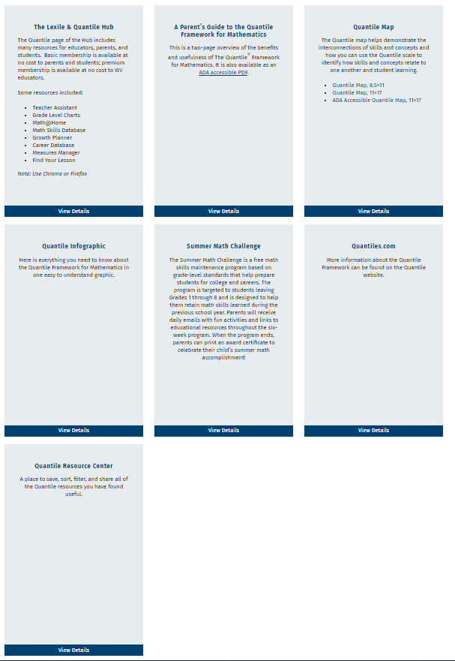
QUANTILE RESOURCES

Slide 73
Listed on the Quantile page are several resources.
Below are directions to locate additional Quantile resources detailed on the West Virginia Lexile and Quantile Measures Report.
QUANTILE RESOURCES

Slide 74
The typical student loses approximately 2.6 months of grade-level equivalency in math skills over the summer months each year.
You can help your student keep his or her math skills sharp over the summer by joining the Summer Math Challenge, a FREE math-skills program designed for students who have just completed 1st through 8th grades. The Summer Math Challenge helps your student retain skills learned during the school year and continue to navigate the path to success in college and career.
SUMMER MATH CHALLENGE

Slide 75
How It Works
For six weeks in the summer, you will receive daily emails with fun activities and links to educational resources. When the program ends, you can print an award certificate to celebrate your student’s summer math accomplishment!
Click “Sign in or register for the Summer Math Challenge.”
SUMMER MATH CHALLENGE

Slide 76
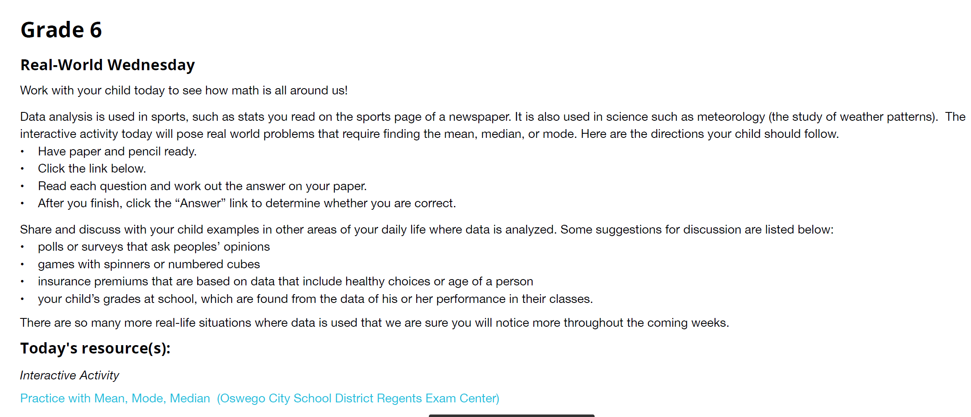
Sample email:
SUMMER MATH CHALLENGE

Slide 77
You can learn more about The Quantile Framework by downloading free resources.
FACT SHEETS

Slide 78
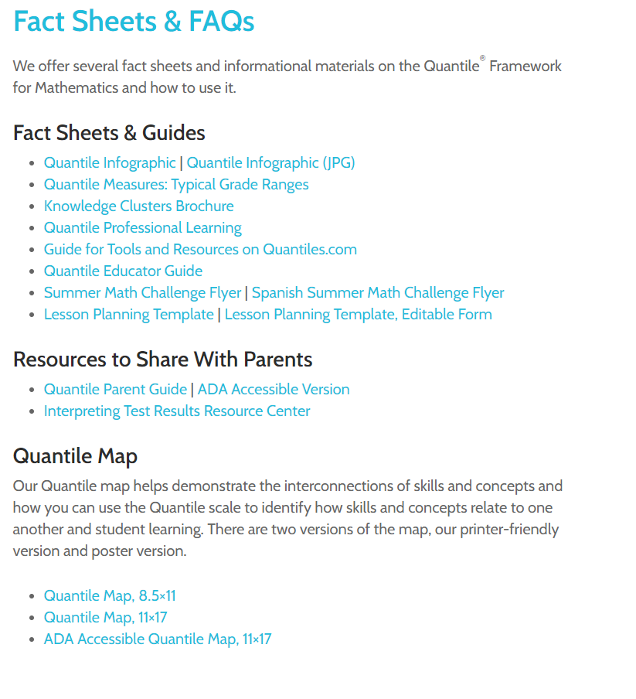
There are many resources to help understand Quantile Measures and students’ math growth.
FACT SHEETS

Slide 79
Free Tools and Resources!
This has been an abbreviated look at a few of the free tools and resources available to you as you help your student advance toward college and career readiness.
Continue your exploration at:
wvde.us/LexilesandQuantiles/
WVDE.US/LEXILESandQUANTILES/
Notes:
79

